Slide 1
My teaching context
At BJK Koleji
Istanbul
Prepared by: Marina Yurchak
English Teacher

Slide 2
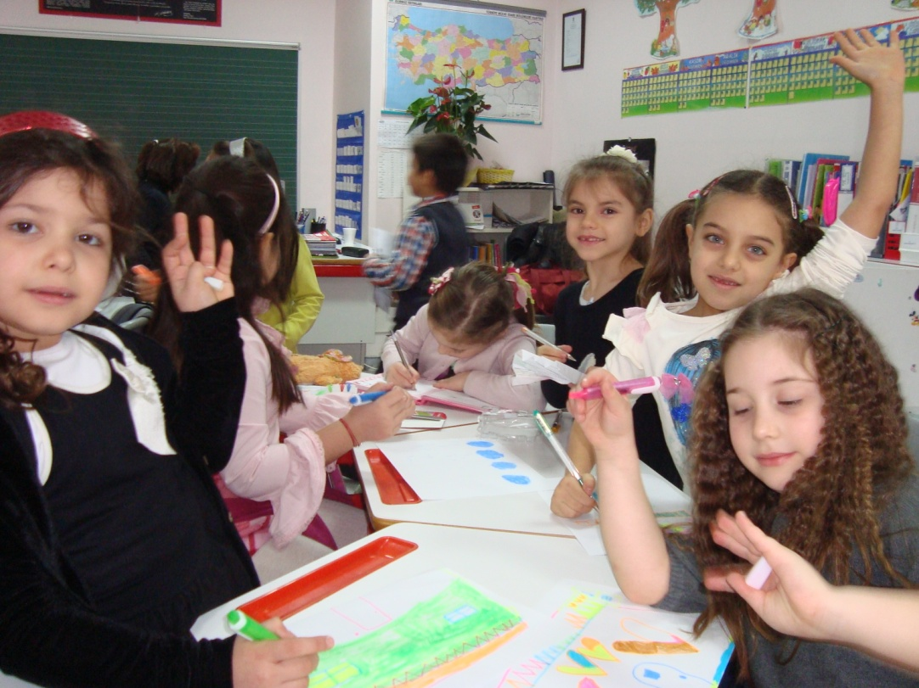
My learners:
Ages 6-9
Grades 1, 2 and 3
11 classes = 220 children
Beginner and elementary level

Slide 3
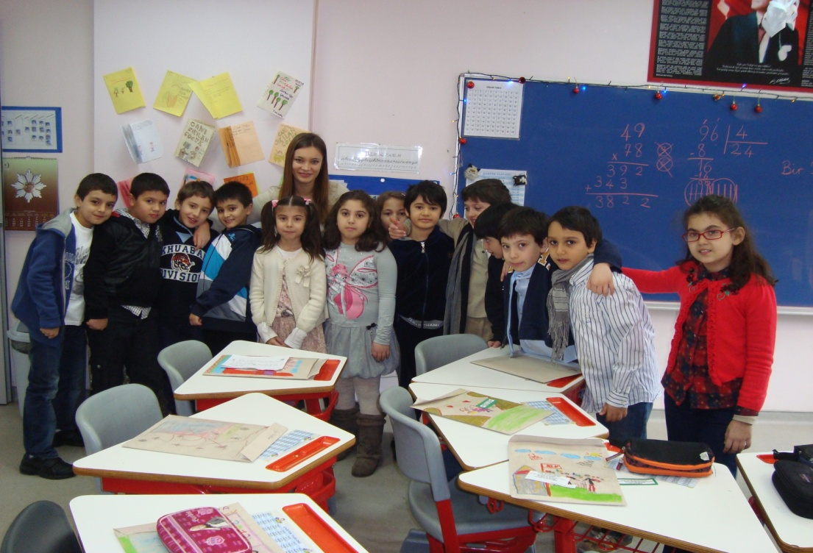
My classrooms
Small but enough space
18 to 22 student per class
Big windows that allow lots of light
Individual desks
Plants and posters

Slide 4
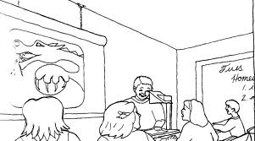
My technological resources
A computer
Over head projector
Internet connection
Ability to print out coloured or b&w worksheets and other materials

Slide 5
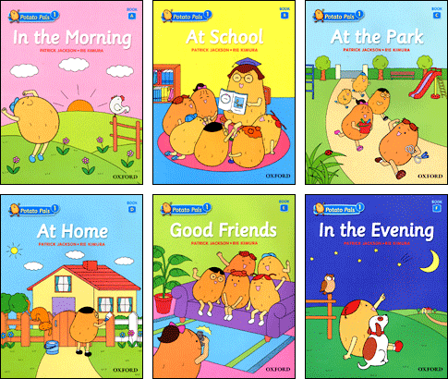
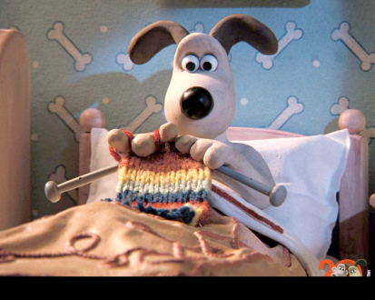
My teaching materials
Authentic materials
Readers with nursery rhymes or stories
Video course “Wallace and Gromit”

Slide 6
Hours
40 minute lessons
2 lessons a week with each class
School day starts at 8:40 and finishes at 16:00

Slide 7
My Program
28 hours a week (with remedial course and a club lesson)
Each term we read 2-3 story books
3rd graders have a quiz twice in a semester

Slide 8
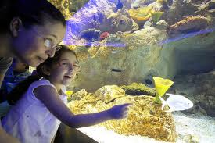
Celebrations and performances
Beginning and end of week Istiklal Marche
Quiz shows
Spelling bee contests
Museum and theatre trips
End of year celebration
Fun Day (demonstrating their knowledge of English)

Slide 9
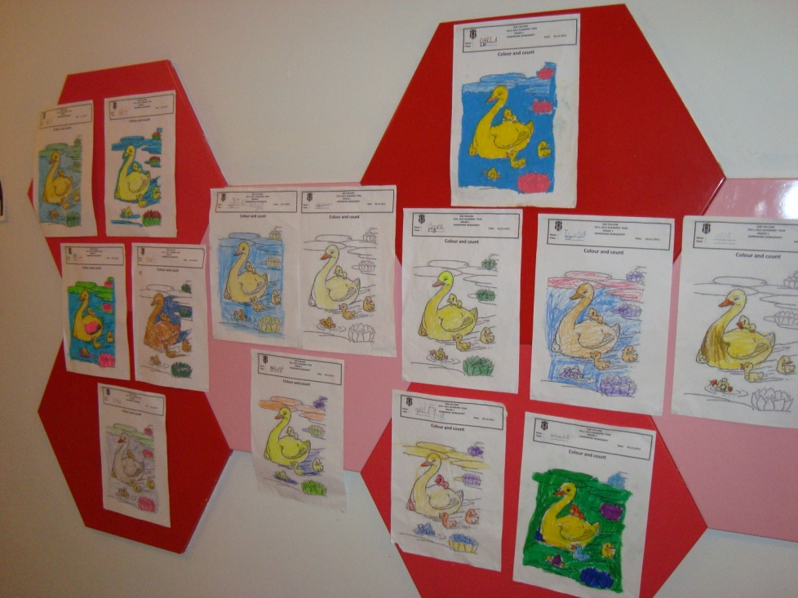
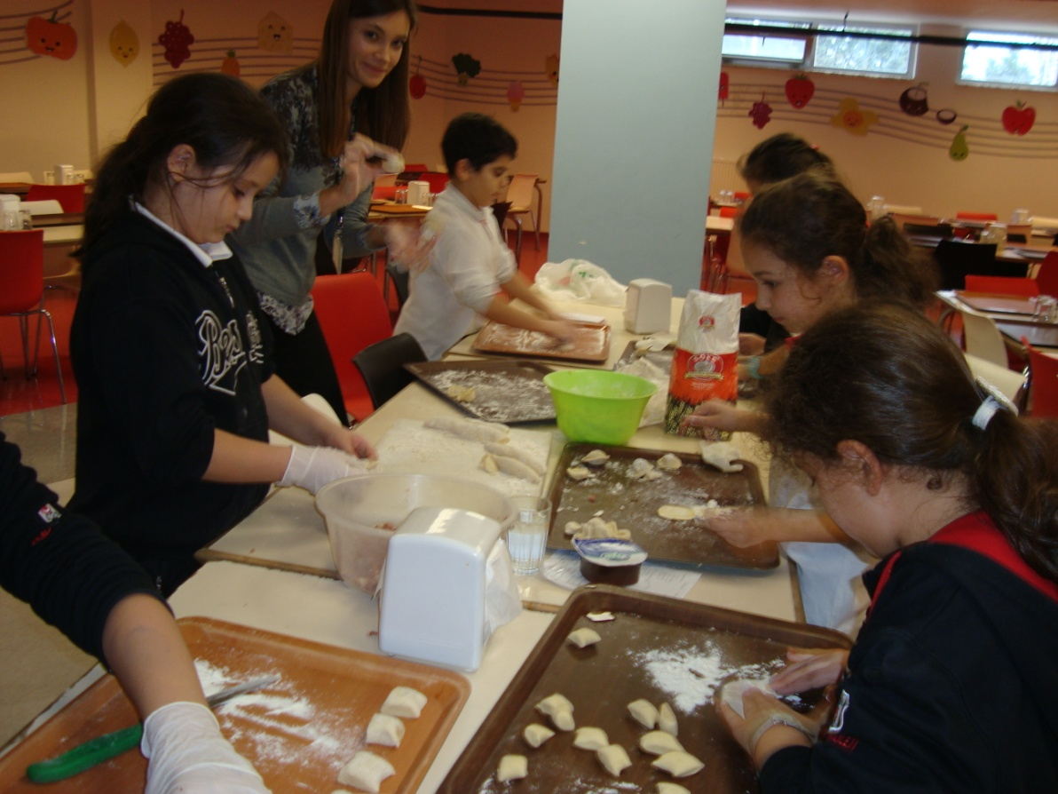
Other responsibilities
Wall projects
International cooking club

